Slide 1
Interactive Videoconferencing In The Classroom
How to bring this powerful educational tool to bear in your classroom on a shoestring budget
Richard Mellott, MA mrmellott1003.weebly.com
Notes:
Begin by mentioning the recent article, talk about budget constraints, then demonstrate how to IVC despite all of the limitations, to bring the world into your classroom.

Slide 2
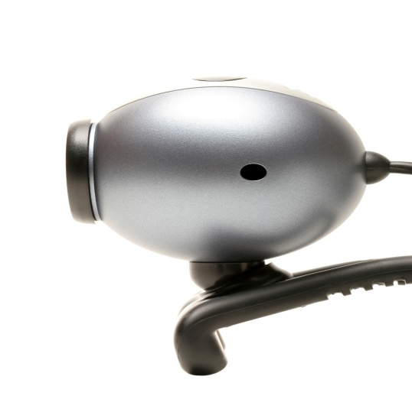
Audience Questionnaire courtesy of Quizdom
Question: How much do you think it costs to have an interactive videoconference between a professional person and your classroom?
A. Free
B. $25-$100
C. $101-250
D. More than $250
Answer: Any of the above, depending on how you set it up. I like A., but I have done B, C, and D.
Notes:
Check the results of this poll, and see where everyone’s imagining the costs are at. Should prove interesting, depending on the audience.

Slide 3
My Background in Videoconferencing (so you don’t feel intimidated)
2007: I had never had a videoconference, nor did I have a webcam on my computer.
Spring, 2008: saw a presentation on IVC at SGVCUE .
May, 2008: bought my first Mac, a Macbook with a built-in webcam.
July, 2008: hosted an IVC with Glen Cornish and a summer school class.
November, 2008: hosted an IVC with Freedom Writers Foundation.
March, 2009:Bought my first PC with a Webcam.
2009: quite a few more, ending with FWF #2.
Notes:
Didn’t IM, didn’t know about Twitter, Facebook, Mafia Wars, but did know about YouTube, MySpace, and GoogleLittrips.

Slide 4
The Platform and Program Issues
Audience Questionnaire: What computers do you have at your school that have webcam capabilities?
Macs
PCs
Both
Neither
Answer: There are several IVC applications for both platforms, and some that work on both. USB Webcams can be added to many desktop and laptop computers of both types, providing they are fast enough to process the audio/video input.
Notes:
Get the technical performance needs from the videogame…I mean, software that comes with the video device.

Slide 5
How to use IVC in a Classroom Setting
Identify your platform and program needs
Contact the professional you wish to work with, and check for compatibility of platforms and programs
Develop a standards-based lesson plan or unit that incorporates the IVC as part of the activities
Run “screen tests” to make sure contact will be successful during actual videoconference
Educate your students and your professional as to the objectives of the interactive videoconference
Host the videoconference, and then have a class debriefing activity, to ensure that your learning objective has been met
Thank you notes from the class should be sent to the professional
Plan your next one!
Notes:
Perform curriculum-related searches, look for experts mentioned in research or author searches. Look for author websites.
Set up dates for test runs, rehearsals, troubleshoot technical issues, make friends with IT specialists.
Send basic lesson plan documents to the professional, and have a discussion about the learning objectives.
Get background info on the guest speaker, and prep your audience. Have them prepare questions.
Read up on the procedures and interviewers/interviewees FAQs.

Slide 6
If it is all so simple, why isn’t it popular?
Audience Questionnaire: What do you feel holds you back from having IVCs as a regular part of your classroom activities?
Equipment issues
Connection issues
Access to professionals of interest
Lesson topics that work
Technological limitations of school/district
Answer: These will always be issues for everyone, but I can guide you through the minefield…trust me!
Notes:
Make friends with IT specialists, Teacher Specialists, and inform your principal of your project, you might get supported!

Slide 7
Interactive Videoconference Examples for your learning pleasure.
A sample videoconference with Glen Cornish and Katie Warren of Painted Light Education Corporation using iChat on a Mac.
An IVC with Dr. Howie DiBlasi, from ISTE’s Special Interest Group on Interactive Videoconferencing, using Skype (on Mac or PC).
Another sample videoconference with Matt from Interlingua in Columbia, using a classroom interface developed by their Spanish Language Instruction company, on either Mac or PC.
Another sample with Troy Tenhet of Global Learning Experience, using Skype, on either Mac or PC.
A recorded video-message on Oovoo, on PC.
Notes:
Check in with everyone and confirm. Modify the PPT to reflect any scheduling difficulties.

Slide 8
Resources for IVC
Here are some resources, if you wish to follow through and begin integrating this method into your classroom/school:
My website: mrmellott1003.weebly.com
An article: Beaming the World Into Our Schools: Getting Into Interactive Videoconferencing
Between these two “jumping in” points, you will be delivered to links to all of the resources I have used in developing my own skills, and much, much more.
Notes:
Remind everyone about the PDFs and links on the website under Videoconferencing webpage. Let them know this PPT will be posted beneath the Presentations page, and also on the Videoconferencing page.

Slide 9
Last Gasp!
Audience Questionnaire:
Now that you’ve been informed about IVCs, do you think you’ll include it in your pedagogical repertoire?
Absolutely!
Very Likely
Maybe?
Nope
Answer: You may use anything you find on my website, in my article, or contact me for assistance in setting up your first IVC.

